Slide 1
Data Transformation Pre-processing

Slide 2
Challenges in Data Transformation
Dependent on application:
Collaborative filtering
Linear Solvers
Clustering
Graphical Model
Graph Structured Prediction and Semi-supervised
Dependent on data type (i.e text vs. images)
Wide variation on formats
Single big file vs. multiple ones
Data type may not be uniform (i.e. in a bayesian network real + boolean)
Notes:
Application listed are the ones targeted by GL

Slide 3
Matrices and Vectors
Data format in matrix/tensor factorization and clustering
NIST’s Matrix Market Format
CSV, TSV
SNAP
Mahout sequence files containing SASV
Matlab matrix
Weka ARFF
SVM-light
libSVM
Output graph: Homogeneous or Bipartite

Slide 4
Graphlab Formats
Graphlab format expects:
Adjacency List in TSV or SNAP(clustering)
Matrix Market Format (clustering, PMF)
*PMF Format (PMF) [M N K]
Graphlab format output:
Metis
Patoh
Zoltan
Custom updated Graph data edge, and vertices
*Binaries (for linear solver x=inv(A)*b)

Slide 5
Proposed workflow
Avoid raw data transformation just handle pre-processing + parsing.
Input requirements:
As a single file / Multiple files
From any of the supported format
*Make decision on supported formats
Output
Graph file/s for graph partition
Format to be described by Jay
Pre-processing: Parsing
Hadoop Post Processing
Graphlab Launching JNI computing
Cleaned Data
Graph Creation
Graph Partition
Jay’s work
The work for these slides
Notes:
Clenaed Data -> Parsing -> Graph Creation (adding edges and vertices) + init -> Graph partition + error checking -> Computing (GL purely) update sync -> Hadoop Post processing

Slide 6
Mahout Sequence Files
Have implementations:
Converting directory of documents to SequenceFile format where the key is the name of the file and the value is all of the text
Creating Vectors from SequenceFile
Generating an output file from a Lucene Index

Slide 7
Weka ARRF
the ARFF file contains the name of the relation, a list of the attributes (the columns in the data), and their type
@Relation, @ Atribute, @ Data tags
Sparse ARRF Filesf

Slide 8
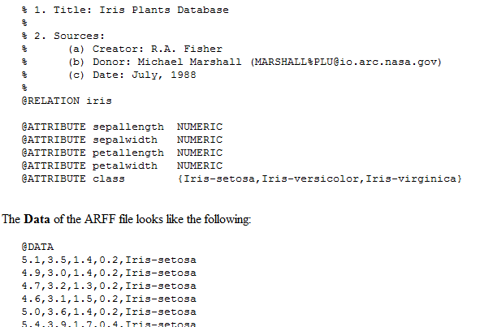
Weka ARRF

Slide 9
Implementation Proposal
Consolidate all parsers that Dany Bickson coded
Add new parsers for supporting new formats
Decide to do either or both:
Map Reduce Version of each parser version (significantly more work as is per case basis)
Write wrapper of C++ code to Map Reduce (using JNI)

Slide 10
Resources
http://math.nist.gov/MatrixMarket/formats.html
https://cwiki.apache.org/MAHOUT/creating-vectors-from-text.html
http://www.skytreecorp.com/support/documentation/
http://graphlab.org/save_c_gl_mat.m
http://bickson.blogspot.com/2012/01/graphlab-input-via-greenplum-sql.html
http://www.cs.waikato.ac.nz/~ml/weka/arff.html
http://weka.sourceforge.net/

